Slide 1
Fluid Power Systems 2023
Simulation Assignment 1
Simscape - Assignment report
Student Fletcher Porter
Student number 100479094
Version 1.0 04.10.2023
Deadline 14.11.2023

Slide 2
Outputs
Upload to MyCourses
This Powerpoint
System parameter file (m-file, script)
The last, Phase 5 simulation model

Slide 3
Updates
No updates yet

Slide 4
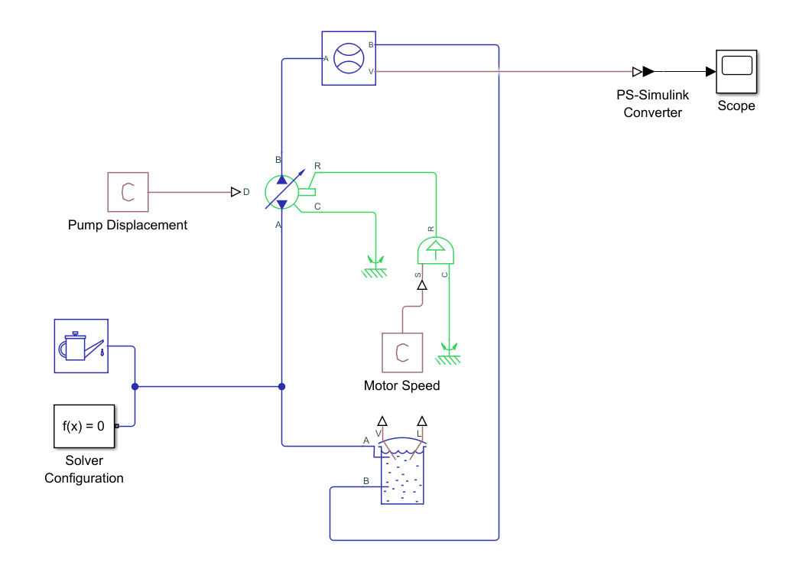
Phase 1 – pump model
Phase 1
Simulink model figure
Simulation model here
FORMAT ⇒ Screenshot ⇒ Send Bitmap to Clipboard
Pump test simulation model

Slide 5
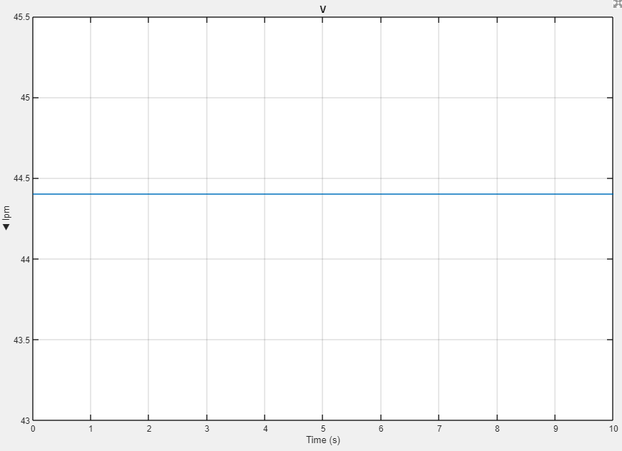
Phase 1 – pump model: simulation results
Phase 1
Parameters and theoretical flow rate without leakages (use parameter values n_{pump} and V_{pump})
n_{pump} | 1800 | [1/s] | rotational speed of pump
V_{pump} | 0.3e-6 | [m³] | pump’s maximum displacement (per revolution)
q_{v.pump.theoretical} | 0.54e-3 | [m³/s] | pump’s flow rate
Simscape model’s outputs
q_{v.pump} | 0.74e-3 | [m³/s] | pump’s flow rate
q_{v} [m³/s]
OR
[l/min]
Pump’s flow rate simulation here
Ctrl + C
Or
File ⇒ Copy to Clipboard
Pump’s flow rate simulation ⇒
Simscape model’s output
t [s]

Slide 6
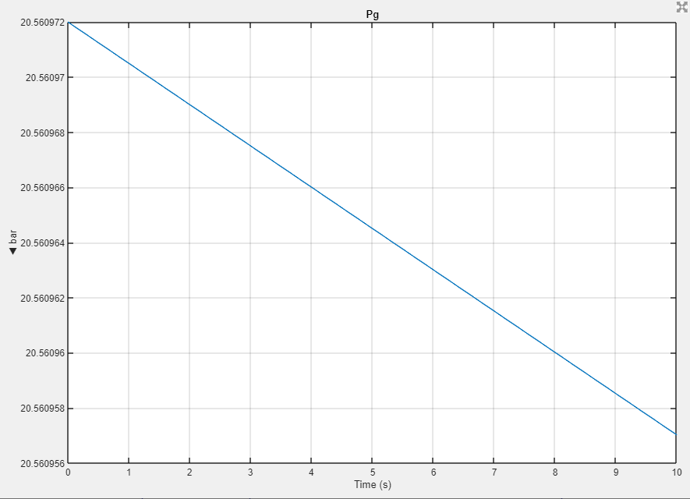
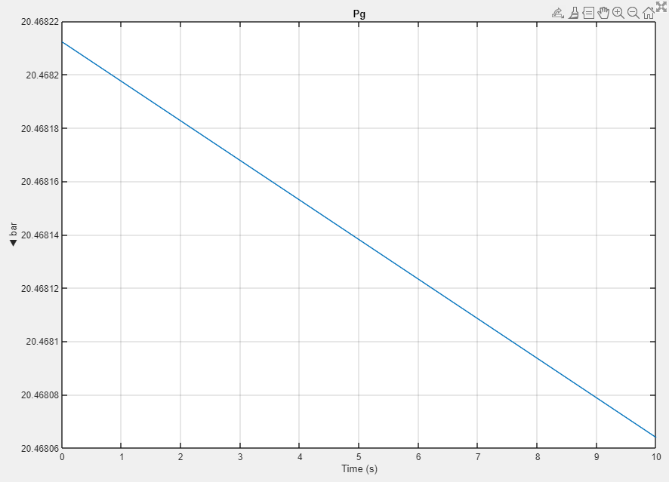
Phase 2: Pump pressure with 1 V and 10 V
Phase 2
p_{pump}
[Pa]
p_{pump}
[Pa]
Pump pressure simulation here
From Simscape Results Explorer
Pump pressure simulation here
From Simscape Results Explorer
t [s]
t [s]
Pump pressure simulation with 1 V valve command
Pump pressure simulation with 10 V valve command

Slide 7
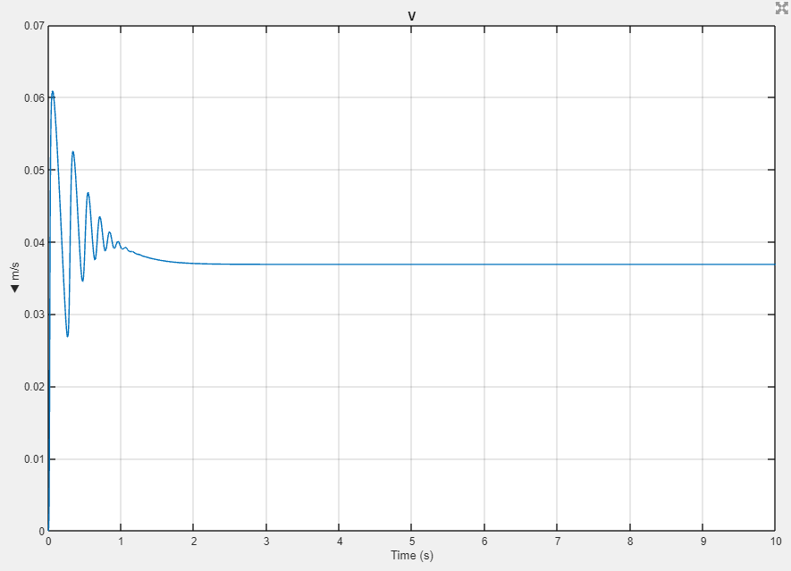
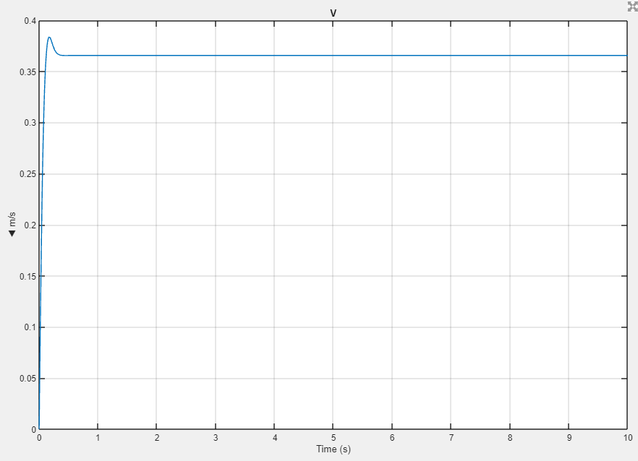
Phase 2: Piston velocity with 1 V and 10 V
Phase 2
With actuator inertia mass 500 kg
Actuator setting: Fluid dynamic compressibility ON
v_{piston}
[m/s]
v_{piston}
[m/s]
Piston velocity simulation here
From piston velocity Scope
Piston velocity simulation here
From piston velocity Scope
t [s]
t [s]
Piston velocity simulation with 1 V valve command
Piston velocity simulation with 10 V valve command

Slide 8
Phase 2 – Hydraulic cylinder, proportional directional control valve, load, and relay control
Phase 2
Simulink model figure
Simulation model here
FORMAT ⇒ Screenshot ⇒ Send Bitmap to Clipboard
Phase 2 system simulation model

Slide 9
Phase 2: calculation results
Phase 2
Outputs
q_{v.pump.theor} |  | [l/min] | pump’s theoretical flow rate, zero-leakage
v_{UP.MAX} |  | [m/s] | theoretical, pump provided maximum velocity up
v_{DOWN.MAX} |  | [m/s] | theoretical, pump provided maximum velocity down
p_{pump.min.m1} |  | [bar] | theoretical minimum pump pressure for lifting the mass m₁, zero velocity, p_{B}= 0 Pa
p_{pump.min.m1} |  | [bar] | theoretical minimum pump pressure for lifting the mass m₂, zero velocity, p_{B}= 0 Pa

Slide 10
Phase 2: simulation results - table
Phase 2
You can replace this with Excel table
 | |V|
m= 500 kg | 2 | 4 | 6 | 8 | 10
|v_{UP}| [m/s]
|v_{DOWN}| [m/s]
p_{min} < 0 Pa (gauge) (0 or 1) | 0 or 1 | 0 or 1 | 0 or 1 | 0 or 1 | 0 or 1
p_{pump.UP} [bar]
p_{pump.DOWN} [bar]
m= 1500 kg | 2 | 4 | 6 | 8 | 10
|v_{UP}| [m/s]
|v_{DOWN}| [m/s]
p_{min} < 0 Pa (gauge) (0 or 1) | 0 or 1 | 0 or 1 | 0 or 1 | 0 or 1 | 0 or 1
p_{pump.UP} [bar]
p_{pump.DOWN} [bar]

Slide 11
Phase 2: simulation results - plots
Phase 2
Piston velocity as a function of proportional control valve command
|v_{UP.500}| [m/s]
|v_{DOWN.500}| [m/s]
|v_{UP.1500}| [m/s]
|v_{DOWN.1500}| [m/s]
Piston velocity plots here
(e.g. Excel plot)
|U| [V]

Slide 12
To be continued!
More slides later!

